Slide 1

HOUSING PRICE PREDICTION FOR MAJOR US CITIES
DATA ANALYTICS BOOTCAMP

Slide 2




SUMMARY
Overview: Housing prices in the United States (US) continue to increase as incomes rise, unemployment drops, and industries grow. Like many, our team wants to predict how housing prices will change over the years as we decide where we want to relocate long-term.
Objective: By analyzing housing market data and trends between 2020-2023, the Housing Price Prediction will predict whether the housing market will rise or drop in the state of California. For example, clients who are looking for new home to buy or rental/investment property will be able to decide where to buy homes based on the number of bedrooms and neighborhoods comparing the housing price.
Presentation Sections:
Data Exploration & Preliminary Analysis
Database
Machine Learning
Dashboard
Notes:
EJ

Slide 3










Technologies Used
Notes:
GL

Slide 4
DATA EXPLORATION & PRELIMINARY ANALYSIS
Notes:
EJ

Slide 5



SOURCING THE DATA
Our team sourced data from verified site to answer our confirmed analysis questions. We pulled multiple sets with information on housing prices with neighborhood and bedrooms count etc. that will support our overall analysis. We will answer the following questions with our data:
Given the data available, can we expect housing prices to increase or decrease in the coming months?
What are the differences in price based on different client needs (example bedroom count, neighborhood etc)
Given a location, what pertinent information should be understood by someone looking to move to the area?
Notes:
EJ

Slide 6
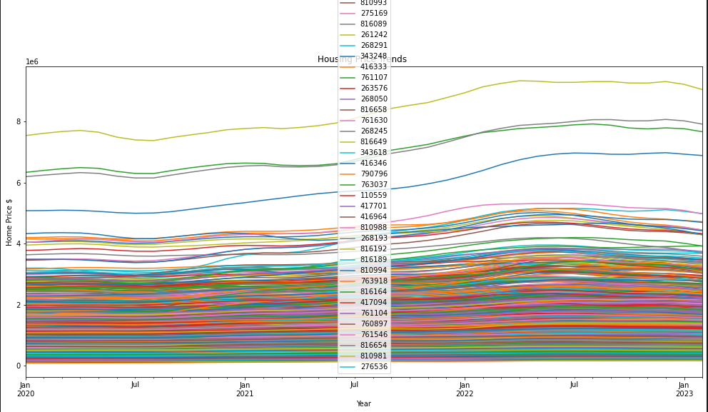
Preliminary Data Processing:
The first steps were to check the kind of data types were inside of the CSV file housing our data for each city. We found that our dataset had city name, state, county and average sales price for all home types inside of that city with time steps of months from 2020 to 2023.
The next was to check for duplicates and null values in the data frames/tables we created.
CA Trends Exploration:
Top Zipcodes have consistently been top performers for the last 3 years
All Zipcode display similar trends in price increase or decrease
Notes:
EJ

Slide 7
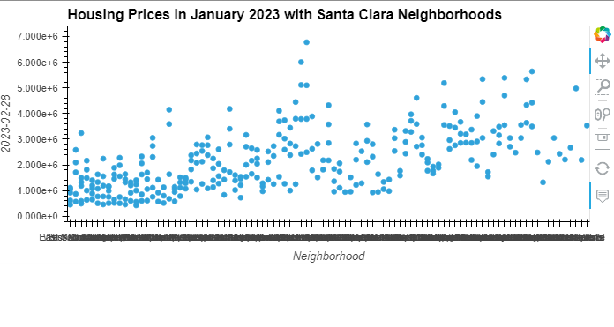
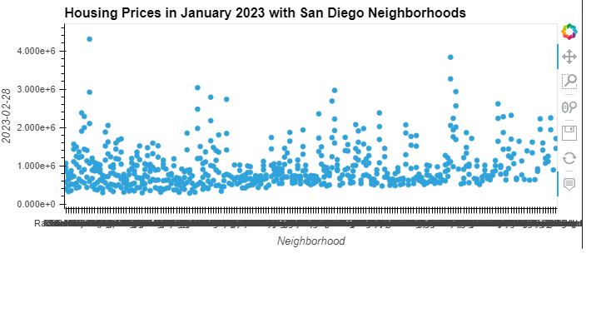
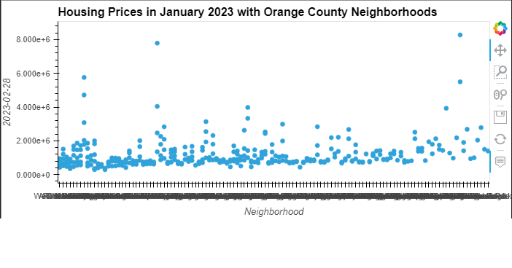
PRELIMINARY ANALYSIS(Linear Regression)
Highest Housing Prices in January 2023 with Neighborhoods
County | Neighborhood | Plot
Santa Clara County | Old Palo Alto, Crescent Park
San Diego County | La Jolla, La Playa
Orange County | Shady Canyon, Newport Coast
Notes:
EJ

Slide 8

DATA AND SOURCES
Zillow - Zillow US House Price Data
Quick Start | Prophet (facebook.github.io)
https://scikit-learn.org/stable/
https://seaborn.pydata.org/
https://matplotlib.org/
https://www.sqlalchemy.org/
https://pandas.pydata.org/
Notes:
EJ

Slide 9
DATABASE AND ETL PROCESS
Notes:
GL

Slide 10
DATA EXPLORATION - THE ETL PROCESS
01
02
03
Extract
Extract clean data from confirmed sources, ensuring it has all necessary information and limited null values
Transform
Transform data, removing null values and unnecessary columns, joining datasets, creating separate data frames
Load
Load the data by writing it into Postgres using the confirmed look-up tables to allow multiple users to access
Notes:
GL

Slide 11

DATABASE PROCESS
Vestibulum
Used postgres by way of pgAdmin as our database to house the tables of data
Used Sql Alchemy to create the database and schemas through Python and extract from the database into our prediction models.
Notes:
GL

Slide 12
Visualization
Notes:
Robert

Slide 13
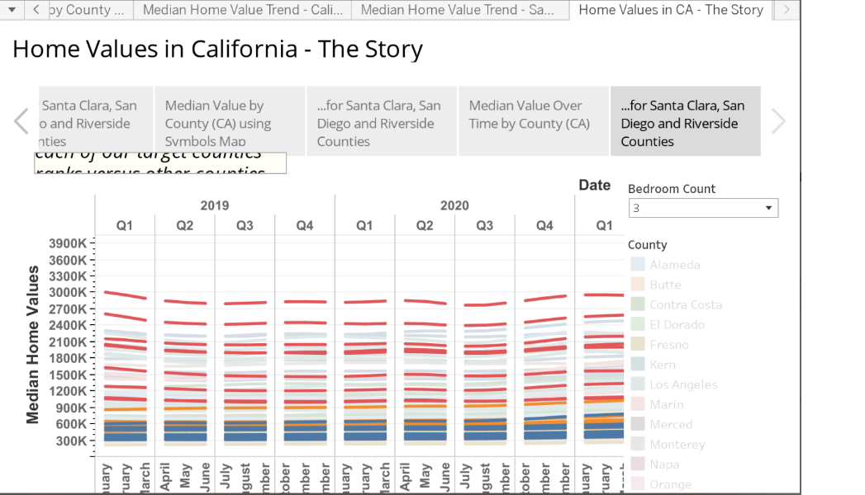
Tableau Analysis
https://public.tableau.com/app/profile/roberth7189/viz/CAHomePrices_16800593056980/HomeValuesinCA-TheStory?publish=yes
Vestibulum
Notes:
Robert

Slide 14
MACHINE LEARNING
Notes:
Chika

Slide 15
The Machine Learning Models Deployed
The selected dataset comprises fifty months housing prices data from Zillow.com (2019-01-31 to 2023-02-28).
These historical prices were used as features for predicting our numerical target/dependent variable (future price).
Supervised learning models, specifically, Linear Regression using scikit-learn, and a newly-researched model known as Prophet Model were both employed to predict home prices.
Vestibulum
Notes:
Chika

Slide 16
The Regression Model
Initially created a Data Frame of home prices in California from February 2019 to February, 2023
Preprocessing: The data was cleaned (e.g., removing irrelevant rows and columns, and then splitting the data into subsets for training and testing the model (using 75% to 25% split respectively)
Training: Since the aim was to develop a model to predict future home prices, we began by training the model to predict February 2023
In preparing the Linear Regression Model, we dropped the previous twelve months data prior to February, 2023, since we wanted to train the model to recognize patterns for prediction.
Validating: We used a small subset of labeled data (y_test) to compare with the model’s predictions (predicted2023_02_28).
Predicting: If the linear regression model satisfies the relevant metrics such as; the model score, R2, MSE, RMSE, and standard deviation, then it can be used in predicting future home prices
Vestibulum
Notes:
Chika

Slide 17
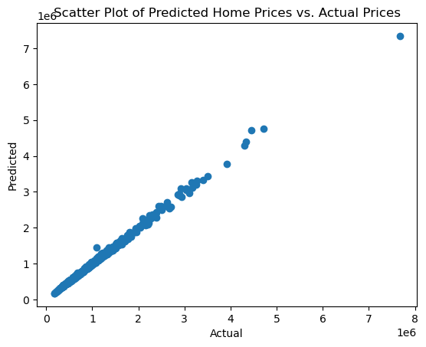
DATA ANALYSIS (REGRESSION MODEL)
Vestibulum
Notes:
Chika

Slide 18
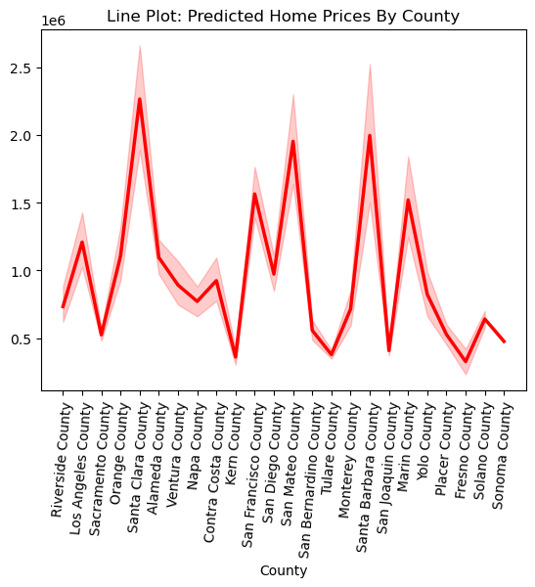
DATA ANALYSIS (REGRESSION MODEL cont..)
Vestibulum
Notes:
Chika

Slide 19
Prophet Prediction model
Two models were created:
One showed the aggregated city-wide data to predict the estimated home value in the coming 5 years for homeowners/investors knowledge
The other shows what the estimated values are for a 6-month window to show how the market may change within the coming months

Slide 20
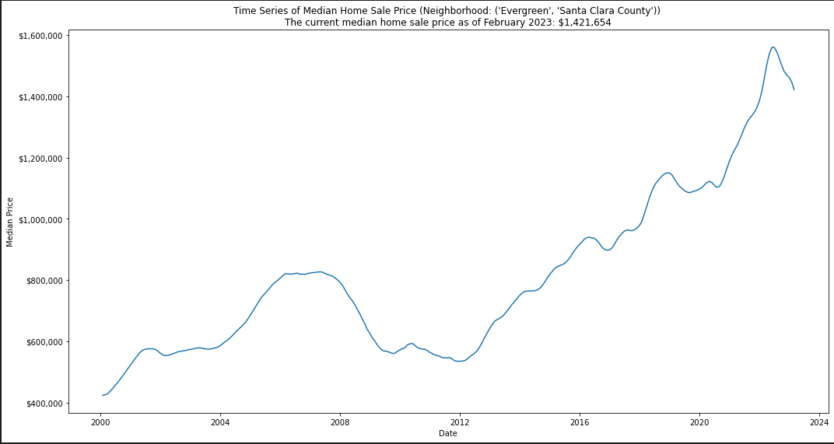
Notes:
Daniel

Slide 21
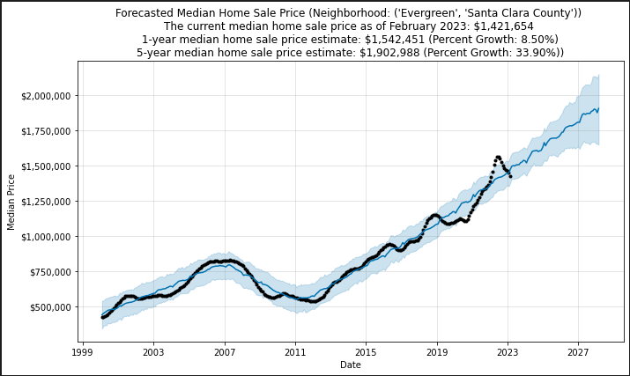
Santa Clara County 5 year Forecast
Notes:
Daniel

Slide 22
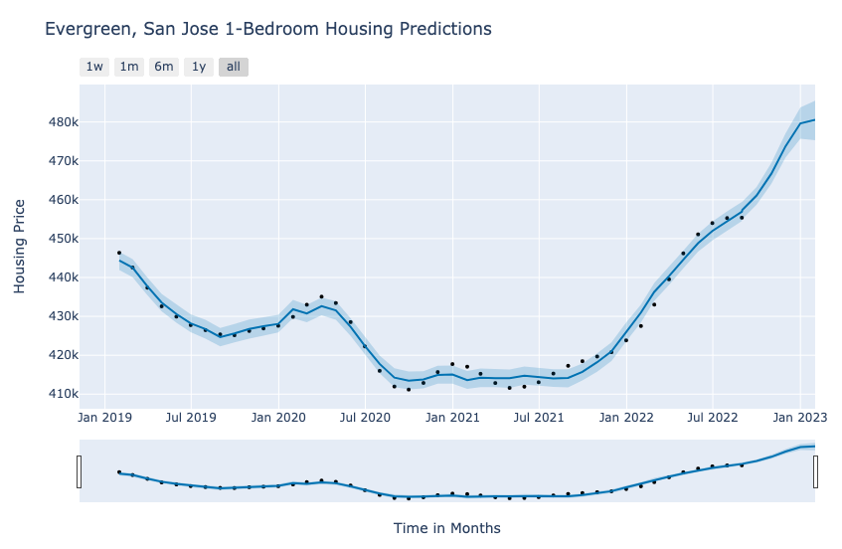
The Data Analyst moving to Silicon Valley for a hot new start-up
The prediction models show that the housing market continues its upward trend.
Predictions are slightly higher than the actual.
County: Santa Clara, City: San Jose, Neighborhood: Evergreen
Dates | Trend | yhat | Actual
7/31/22 | $ 455,655 | $ 454,460 | $ 455,288
8/31/22 | $ 460,011 | $ 456,911 | $ 455,381
9/30/22 | $ 464,367 | $ 461,092 | $ 454,396
10/31/22 | $ 468,724 | $ 466,705 | $ 452,787
11/30/22 | $ 472,939 | $ 473,797 | $ 451,908
12/31/22 | $ 477,295 | $ 479,652 | $ 451,690
1/31/23 | $ 481,652 | $ 480,567 | $ 459,199
Notes:
Ray

Slide 23
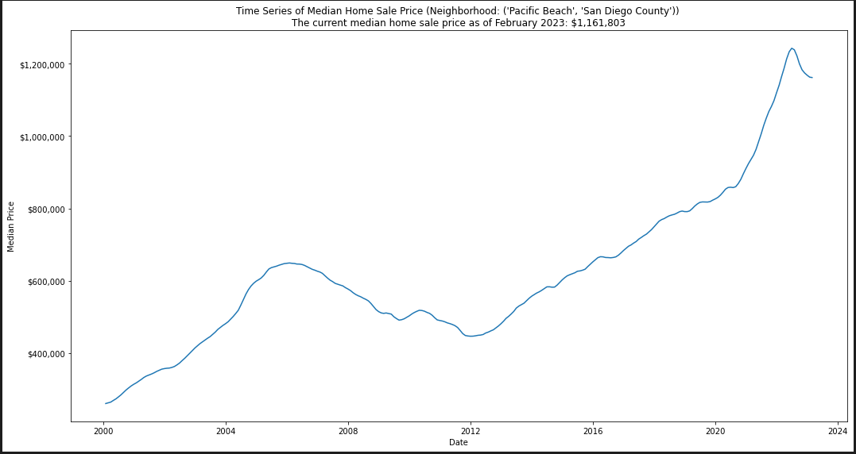
Notes:
Daniel

Slide 24
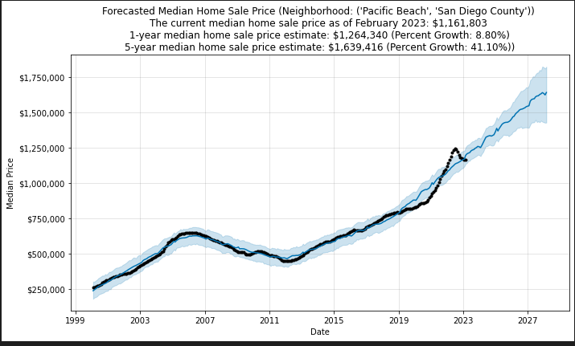
San Diego County 5 year Forecast
Notes:
Daniel

Slide 25
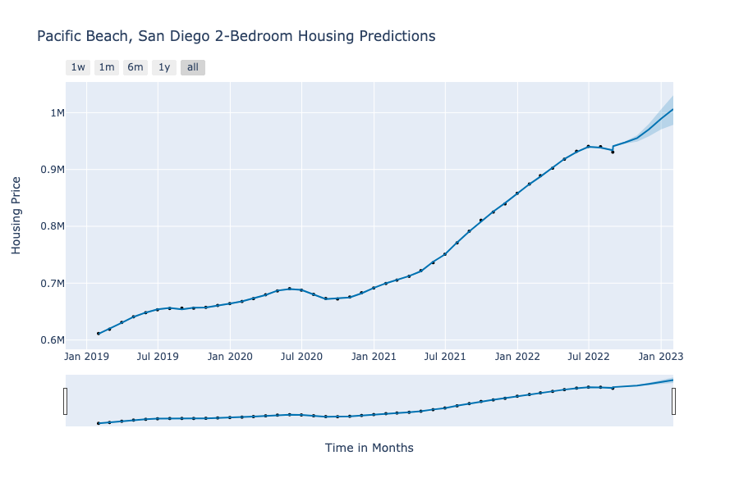
LA couple moving to San Diego for the calm and peace
County: San Diego, City: San Diego, Neighborhood: Pacific Beach
The prediction shows a jump in pricing at the start of the model.
With a small data group the prices seem to split close and past 6 months.
Date | Trend | yhat | Actual
7/31/22 | $ 937,482 | $ 938,397 | $ 940,094
8/31/22 | $ 948,594 | $ 933,731 | $ 930,558
9/30/22 | $ 959,705 | $ 947,526 | $ 916,597
10/31/22 | $ 970,817 | $ 955,358 | $ 905,405
11/30/22 | $ 981,570 | $ 970,499 | $ 899,280
12/31/22 | $ 992,681 | $ 989,449 | $ 894,110
1/31/23 | $ 1,003,792 | $ 1,006,322 | $ 895,426
Notes:
Ray

Slide 26
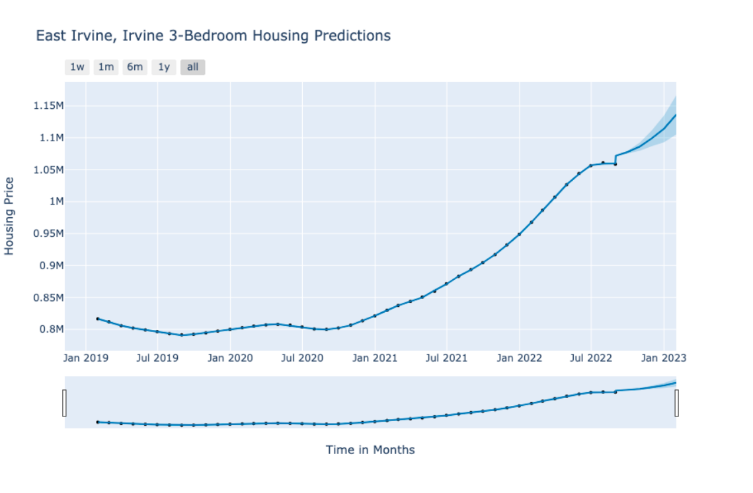
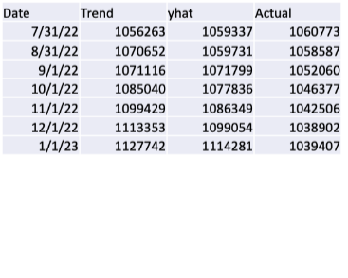
LA family moving to Irvine for good schools
County: Orange, City: Irvine, Neighborhood: East Irvine
From the predictions, the Irvine market for three bedroom continues to increase as Irvine continues to be a new hotspot.
The Prophet model notes an increase in pricing. This model can continue to be optimized to lower the initial jump in pricing
Notes:
Ray

Slide 27
CHALLENGES & RECOMMENDATION
We would explore more machine learning models and fine tune them to try and get a better fitting model.
One major area where we feel we could have improved our project is by taking more time to discover more data sets and factors that may influence housing prices (Example: Population, Square feet area, Average rent, Crime rate, Price of gas, Health care).
There are likely many variables we could not find data on handily, and that would probably be the best place to improve our project.
Vestibulum
Notes:
EJ

